Slide 1
Source Separation with Convolutional Denoising Autoencoders
Dan Park & Josh Miao

Slide 2
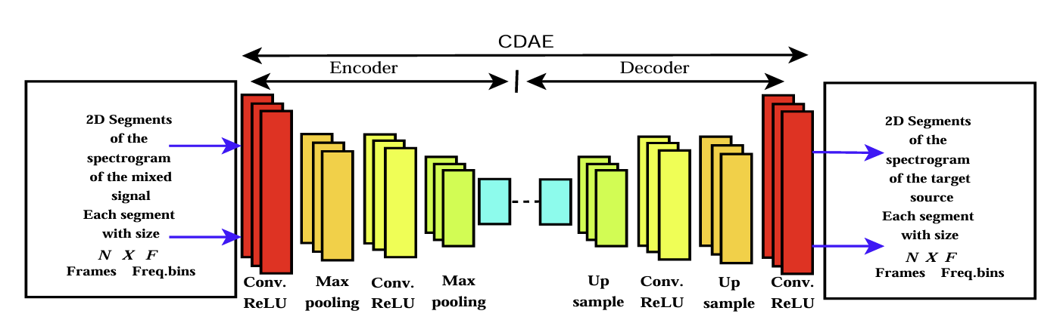
Source Separation
Extract targeted voices(instruments) from mixed sources
Spectrogram -> CNN -> encoder -> decoder -> learned masks
Skip connections(not in paper)

Slide 3
MIR-1K
1,000 Chinese karaoke audio tracks
Vocals in right channel, accompaniment in left channel
Also contains stuff like:
Lyrics in plain speech
Pitch frame Labels
Unvoiced frame labels
8:1:1 training splits

Slide 4
Convolutional Denoising Autoencoder(CDAE)
U-net:
Learns the noise mask to extract
Masks non-targeted source
2 Independent CDAEs and training loops
L/R channels as ground truth
Inference
Yields separated source audios
encoder -> decoder
Skip connection from output of each encoder layer to input of penultimate layer in decoder

Slide 5

Separated Audio Samples
Raw Input
Isolated Vocals
Isolated Accompaniment

Slide 6
Performance Metrics
Signal to distortion ration(SDR)
Like SNR, overall audio quality
Signal to interference ratio(SIR)
How much of removed source remains
Presence of artifacts not present in original audio
Signal to artifact ratio(SAR)

Slide 7
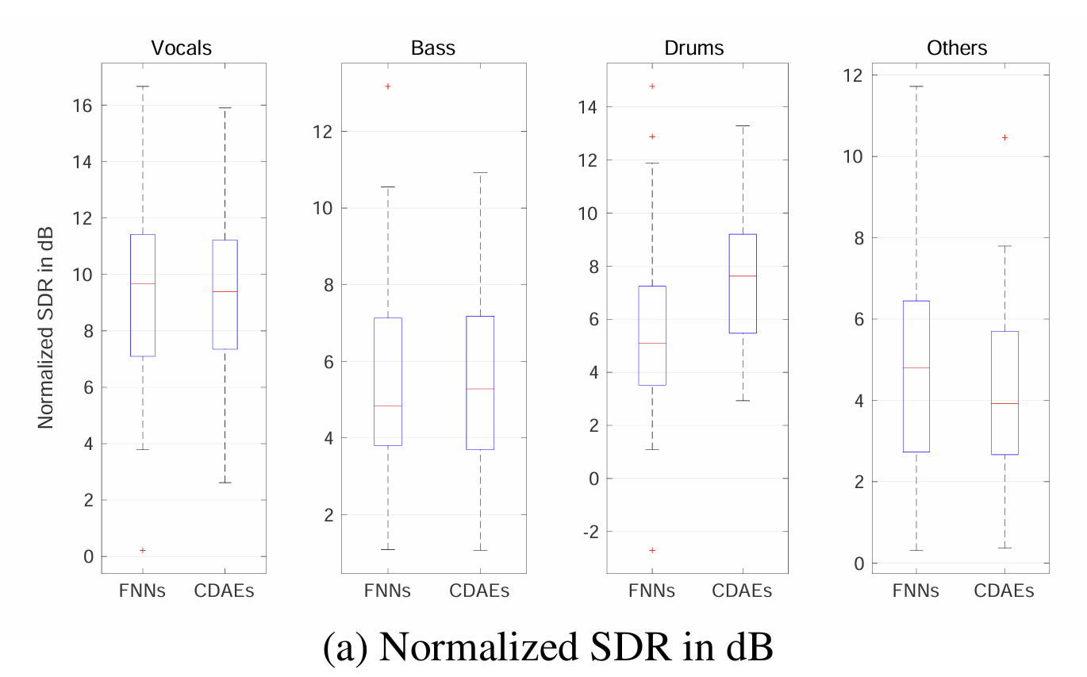
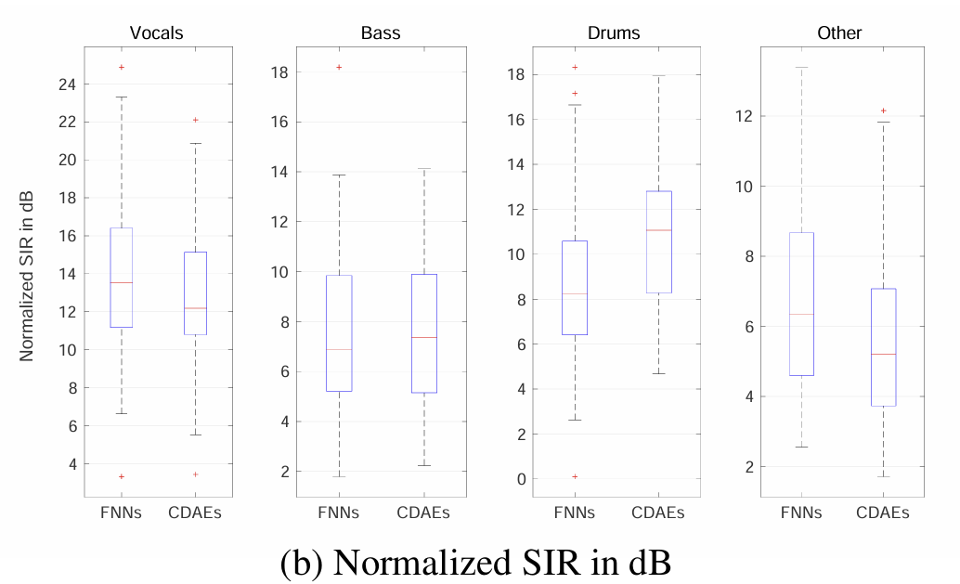
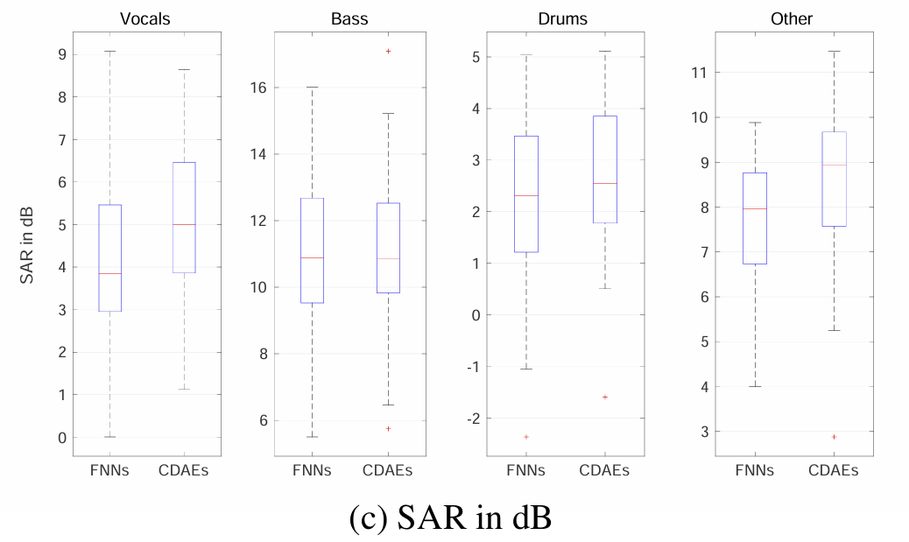
Box & Whisker(Paper)

Slide 8
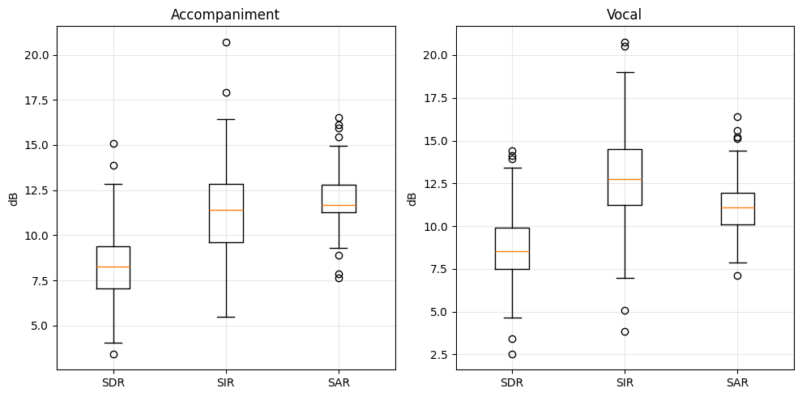
Box & Whisker (Achieved)

Slide 9
Achieved Statistics
Accompaniment :
SDR(dB): Min = 3.83, Mean = 8.28dB, Max = 15.01, IQR = 2.15
SIR(dB): Min = 4.87, Mean = 11.27, Max = 19.52, IQR = 3.35
SAR(dB): Min = 8.76, Mean = 11.88, Max = 16.96, IQR = 1.44
Vocal :
SDR(dB): Min = 3.31, Mean = 8.61, Max = 14.95, IQR = 2.45
SIR(dB): Min = 4.86, Mean = 12.81, Max = 20.30, IQR = 3.28
SAR(dB): Min = 7.79, Mean = 11.14, Max = 16.60, IQR = 1.78

Slide 10
Notes:
This slide is just for comparison so people can see how we did relative to the paper

Slide 11
Challenges
Version incompatibilities with PyTorch
Overall pretty smooth tbh

Slide 12
References
Paper
Colab Notebook
Drive
MIR-1K Dataset
Source code
Saved Models
Separated source audios

